Slide 1
Git It Together!
PRERNA MITTAL
BETA MICROSOFT LEARN STUDENT AMBASSADOR

Slide 2
AGENDA
What is Git? Why use it?
Installation and configuration
Getting started with basic commands
Creating a repository
Introduction to GitHub
Stages in Git and commands
Branches in Git
Create your first pull request
About MLSA program

Slide 3

What is Git ?
A command line utility
You can imagine git as something that sits on top of your file system and manipulates files.
free and open source distributed version control system
Version control systems is used for source control for managing and tracking software code.

Slide 4
Why is Git useful ?
• You have to submit your assignment by today and the assignment is ready for submission.
• While testing it you discovered a minor bug and decided to fix it.
• After attempting to do so, you accidentally changed a working code and got yourself in a big mess.
• You no longer remember what it was.

Slide 5


Slide 6


Introduction to GitHub
GitHub is a web-based Git repository hosting service.
Where anyone can post their projects.

Slide 7


Slide 8
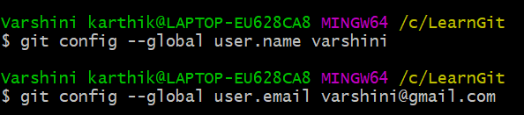
Installation and configuration
Git can be downloaded from this link: https://git-scm.com/downloads
First time configuration commands:
> git config --global user.name xxxx
> git config --global user.email email

Slide 9
Getting started with basic commands
cd
To move from the current working directory to another directory
ls
It is used to list the files in that particular directory
mkdir directoryname
It is used to make a new directory
rm
It is used to remove a file from a directory

Slide 10
Getting started with basic commands
git --version
To check the current version of the git
git init
To initialize a new and empty repository
git status
It lists all the files that have to be committed
git log
It is used to list the commit history for the current branch
git branch
It lists all the local branches in the current repository

Slide 11
Getting started with basic commands
git add .
To add all files to the commit
git commit –m “first commit”
To commit the files added, to the repo
git push
To finally push your changes to the repo

Slide 12
Step 1: Initialize a repo - Git
$ cd ~/Desktop
$ mkdir demo
$ cd demo/
$ git init

Slide 13
Step 2: Add a new file to the repo
$ echo [some text here] > demo.txt
$ ls
$ git status

Slide 14
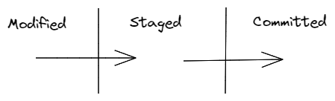
Stages in git
There are three stages in git:
Modified
Staged
Committed

Slide 15
Step 3: Add a file to the staging environment
$ git add .
$ git status

Slide 16
Step 4: Create a commit
$ git commit -m "This is my first commit!"

Slide 17
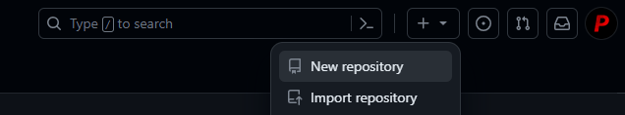
Step 5: Creating a new repository - GitHub
We are pushing our changes to GitHub now!

Slide 18
Step 6: Set main Branch
$ git branch –M main
$ git branch

Slide 19

Branches in git
Branches allow you to move back and forth between 'states' of a project.

Slide 20
Commands for branch
git branch branchName
To create a new branch
git branch -a
It is used to list all the existing branches
git checkout branchName
It switches to the newly created branch
git branch –D branchName
It is used to delete a particular branch
git branch –d branchName
It is used to delete a branch after merge
git checkout –d branchName
It is used to create and checkout a new branch

Slide 21
Step 7: Connect remote and local
$ git remote add origin <URL>

Slide 22
Step 8: Push to GitHub
$ git push –u origin main
Go back to GitHub and refresh the page to see your changes!

Slide 23
Make your first Pull Request!

Slide 24

Step 1: Fork the Repo
https://github.com/prernamittal/mlsa-workshop-diy

Slide 25
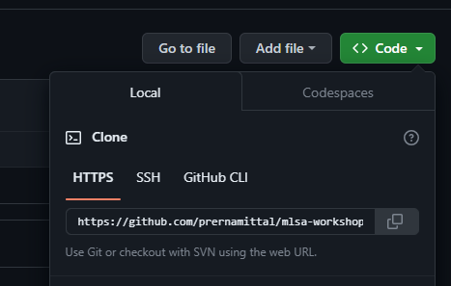
Step 2: Clone the Repo
https://github.com/<your github username>/mlsa-workshop-diy
$ git clone <your forked repo URL>

Slide 26
Step 3: Create a branch
$ git checkout -b [BranchName]
Please put your name as BranchName here!

Slide 27
Step 4: Connect Remote to Local
$ git remote add upstream https://github.com/prernamittal03//mlsa-workshop-diy

Slide 28
Step 5: Make your changes
Append your name to the contributors list in the HTML file in the cloned repo and save the changes.
Check with “git status”
If this shows “no changes to be committed”, just add a new file in the folder with your name

Slide 29
Step 6: Add, Commit, Push
$ git add .
$ git commit –m “added my name”
$ git push –u origin [BranchName]

Slide 30
Step 7: Go back to GitHub, your forked repo page
You’ll see a button “Compare & pull request” and click it.
Open a pull request by clicking the "Create pull request" button.
Now submit the pull request.

Slide 31
